Slide 1
Lecture 3: Foreign Language Knowledge and Course Planning

Slide 2
Questions/issues addressed in this lecture
What kinds of knowledge does a language user need to have in order to use the language effectively?
What is competence and performance?
What is communicative competence?
What is declarative and procedural knowledge?
Is competence related to performance?
What is our starting point in language course design?

Slide 3
Our goal as language teachers
To help students learn a second language in the classroom setting and become proficient in that language.
  What does proficient mean?
  How does one achieve proficiency?
  What does “knowing” a language mean? What knowledge/skills does one need to have in order to be proficient in a language?

Slide 4
Note down all kinds of knowledge someone needs to have in order to be proficient?

Slide 5
To know a language actually means to have native-like communicative competence (and literacy)
(b) Knowledge of language entails knowing, on the one hand, how it works as a structural system (i.e., knowing rules of language usage) and, on the other how it is used in different social situations or communicative events (i.e., knowing rules of use).
(c) Knowledge of language means having internalised rules of usage and use and being able to put them into practice to understand and produce sentences, paragraphs or larger texts (oral and written).
(d) Some FL applied linguists believe that knowledge regarding language use entails sociolinguistic knowledge as well as knowledge of communicative strategies.
(e) To know a language also means to know about the culture and society in which it is used

Slide 6
What proficiency is not…
What proficiency is NOT:
  It is not a theory of language acquisition.
  It is not a method of language instruction.
  It is not a syllabus or an outline to inform our curricula.
  It is not a preoccupation with grammar or accuracy.
So, what is it?

Slide 7
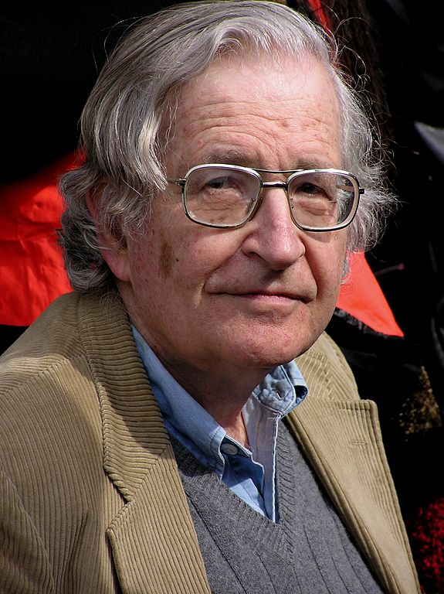
Competence and performance: Historical developments
Chomsky (1965) was the first to distinguish between a speaker’s competence and his/her performance:
Competence is what you know.
Performance is what you do.
[1]

Slide 8
Competence
Competence refers to the implicit knowledge a native speaker has of linguistics rules (usage)of his language.
This knowledge has been internalised in childhood.
This knowledge enables a native speaker to produce and understand grammatically correct sentences

Slide 9
Performance
Performance refers to the actual use of the language.
Performance is contaminated and impure (influenced by memory limitations, distractions, errors, false starts, etc.) and does not reflect a speaker’s underlying competence.
Performance is not a true reflection of our competence.

Slide 10
Communicative competence (1/2)
Hymes (1960s) regarded Chomsky’s definition of competence as restrictive.
He introduced the distinction between “sociolinguistic (or contextual) competence” and “linguistic (or grammatical) competence”.
Linguistic competence is part of one’s communicative competence.

Slide 11
Communicative competence (2/2)
Hymes maintains that a proficient speaker has internalised linguistic rules (what is grammatical and what is not).
S/he has also internalised social rules of language use; s/he knows when to speak or write, to whom and how, s/he knows how to talk and write appropriately.
A proficient speaker knows that his/her linguistic choices depend on the context of situation (setting, participants, purpose, channel and topic).

Slide 12
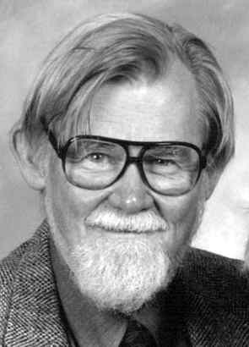
Hymes and Communicative Competence
Communicative Competence encompasses both knowledge of usage and use of language.
[2]

Slide 13
Communicative competence language teaching (1/2)
The concept of communicative competence was introduced into language teaching.
Communicative competence refers to the different kinds of knowledge a learner needs to develop in order to be able to communicate effectively in a language.

Slide 14
Communicative competence language teaching (2/2)
Canale & Swain (1980) attempted to clarify the notion of communicative competence by establishing a framework that consisted of four major components:
  Grammatical competence,
  Sociolinguistic competence,
  Discourse competence,
  Strategic competence.

Slide 15
Components of communicative competence (1/2)
Linguistic or Grammatical competence | Knowledge of language forms and their meaning; i.e. knowledge of the form and meaning of words, how words form grammatically correct (and meaningful) sentences, as well as knowledge of how to pronounce and spelling words.
Sociolinguistic or Pragmatic competence | Knowledge of the social rules of language and discourse. Language users’ ability to: select language which is contextually appropriate, understand the intended meaning (illocutionary force) of utterances.

Slide 16
Components of communicative competence (2/2)
Discourse competence | Knowledge of how to use language, given the discursive context to articulate socially meaningful speech or writing (e.g. political discourse, legal discourse, advertising discourse), which: is cohesive and coherence, follows the rules of use of a specific text type (genre) .
Strategic competence | Knowledge of communication strategies to enhance the effectiveness of communication or to compensate for communication breakdowns (e.g. use of paraphrase, word-coinage, repetition, appeals for help).

Slide 17
Fluency vs. Accuracy
Fluency:
  Ability to produce written and spoken language with ease.
  Ability to communicate ideas effectively.
  Ability to produce continuous speech without tiring the listener, without causing comprehension difficulties or breakdown in communication.
Accuracy:
  Ability to produce grammatically correct sentences.

Slide 18
Bachman’s Model:
Pragmatic Competence
Illocutionary knowledge (functional knowledge).
Ideational function: intended to convey ideas and express people’s experiences of the real world.
Manipulative function: intended to persuade or dissuade (used to affect the world around them).
Heuristic function: intended to explore ideas and feelings and to extend people’s knowledge of the world around them.
Imaginative function: where language is used creatively for aesthetic or humorous purposes.

Slide 19
Declarative and Procedural Knowledge (1/2)
Declarative knowledge: Knowing about something.
Procedural knowledge: Knowing how to do something.

Slide 20
Declarative and Procedural Knowledge (2/2)
Does knowing about a language mean that we are able to use it?
Is one type of knowledge more important than the other?
Is the goal of foreign language teaching to produce users of the language or literate users of the language (who can also talk about the language and its use)?

Slide 21
Competence and performance
Competence: knowledge of; ability to do something.
Performance: actually doing it.
Does having the ability to do something mean that we can actually do it?
What do we assess in tests?

Slide 22
Starting points in course design (1/4)
In order to decide what knowledge is to be included in a course, the course designer has two options to start from:
  The language: looking at the totality of language and trying to identify what needs to be taught and learnt.
  The learner: who the learner is and what s/he needs to use the language for.

Slide 23
Starting points in course design (2/4)
Depending on the starting point the course, the designer will ask two different questions.
  Question 1: What must EFL learners know about English and which skills must they have developed in order for them to communicate successfully?
  Likely answer: They must know how the English linguistic system operates and they must have developed the skills to understand and produce spoken and written English.

Slide 24
Starting points in course design (3/4)
  Question 2: What will the EFL learners/users need to do with the language; that is, what will they be using English for?
  Likely answer: It depends on who the learners/users are and what their sociocultural context is.

Slide 25
Starting points in course design (4/4)
How will the starting point affect what gets included in a course?
There is no universal conception of what knowledge in a foreign language entails. It all depends on what your starting point is – the language or the learners.

Slide 26
References
Bachman, L. F. (1990). Fundamental considerations in language testing. Oxford University Press.
Canale, M., & Swain, M. (1980). Theoretical bases of communicative approaches to second language teaching and testing. Applied Linguistics,1, 1-47.
Chomsky, Noam (1965), Aspects of the Theory of Syntax, Cambridge, Massachusetts: MIT Press.
Færch, C., Haastrup, K., & Phillipson, R. (1986). The role of comprehension in second language learning. Applied Linguistics, 7, 257-74.
Hymes, D. (1970). On communicative competence. In Gumpertz, J.J. & Hymes, D. (eds.) Directions in Sociolinguistics. New York: Holt, Rinehart & Winston.

Slide 27
Task 1: Discuss the following questions:
1. Do all the so-called ‘native-speakers of a language know the same things about it, and can they all do the same things with it? How much does their knowledge about language and their performance with it depend on their social background, education and level of literacy?
2. What types of knowledge, communicative competence(s), and what kind of skills do L1 users of a language have?

Slide 28
Task 2: Provide informed responses to the following questions:
1. What does ‘to know a language well’ and ‘to use it successfully’ mean?
2. What kinds of FL knowledge, competence or ability, and skill(s) must one have?
3 What do we mean when we say that a person is a ‘competent user’ of the language?

